Slide 1

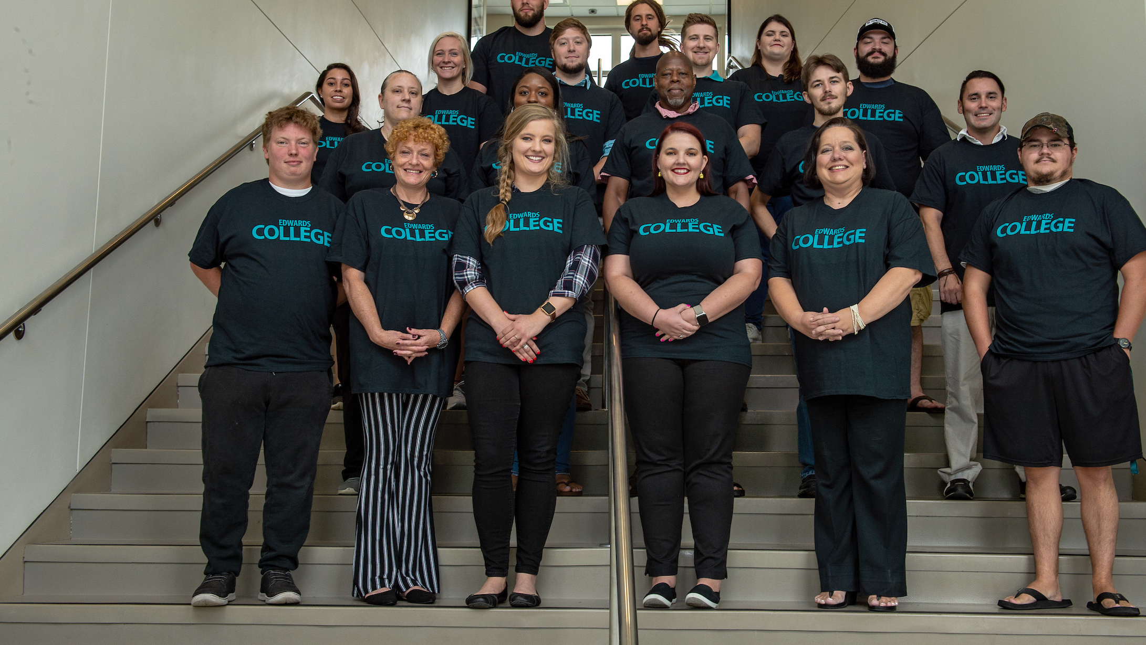
Welcome to the Edwards College of Humanities and Fine Arts
Please open your chat to ask questions and visit https://www.coastal.edu/graduatestudies/ to request more information.

Slide 2
Opportunities
Professional and Scholarly Development
Collaborative Research
Faculty Mentorship
Please open your chat to ask questions and visit https://www.coastal.edu/graduatestudies/ to request more information.

Slide 3
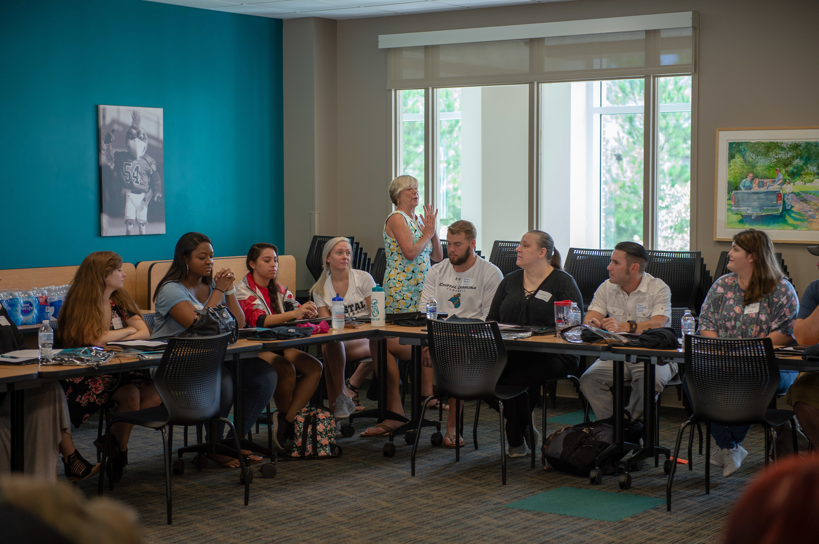
Master of Arts in Communication
Our newest and one of our most popular degrees is the MA in Communication, which is a 33-credit-hour program with concentrations in Leadership and Advocacy.
Please open your chat to ask questions and visit https://www.coastal.edu/graduatestudies/ to request more information.

Slide 4
For More Information
Program Coordinator Dr. Deborah Breede
dbreede@coastal.edu
843-349-6481
Please open your chat to ask questions and visit https://www.coastal.edu/graduatestudies/ to request more information.

Slide 5
Master of Arts in Liberal Studies
This 30-credit-hour program allows students to pursue advanced interdisciplinary study in humanities, arts and social sciences. It is a great way to get a flexible advanced degree!
Please open your chat to ask questions and visit https://www.coastal.edu/graduatestudies/ to request more information.

Slide 6
For More Information
Program Coordinator Dr. Shari Orisich
sorisich@coastal.edu
843-349-6669
Please open your chat to ask questions and visit https://www.coastal.edu/graduatestudies/ to request more information.

Slide 7
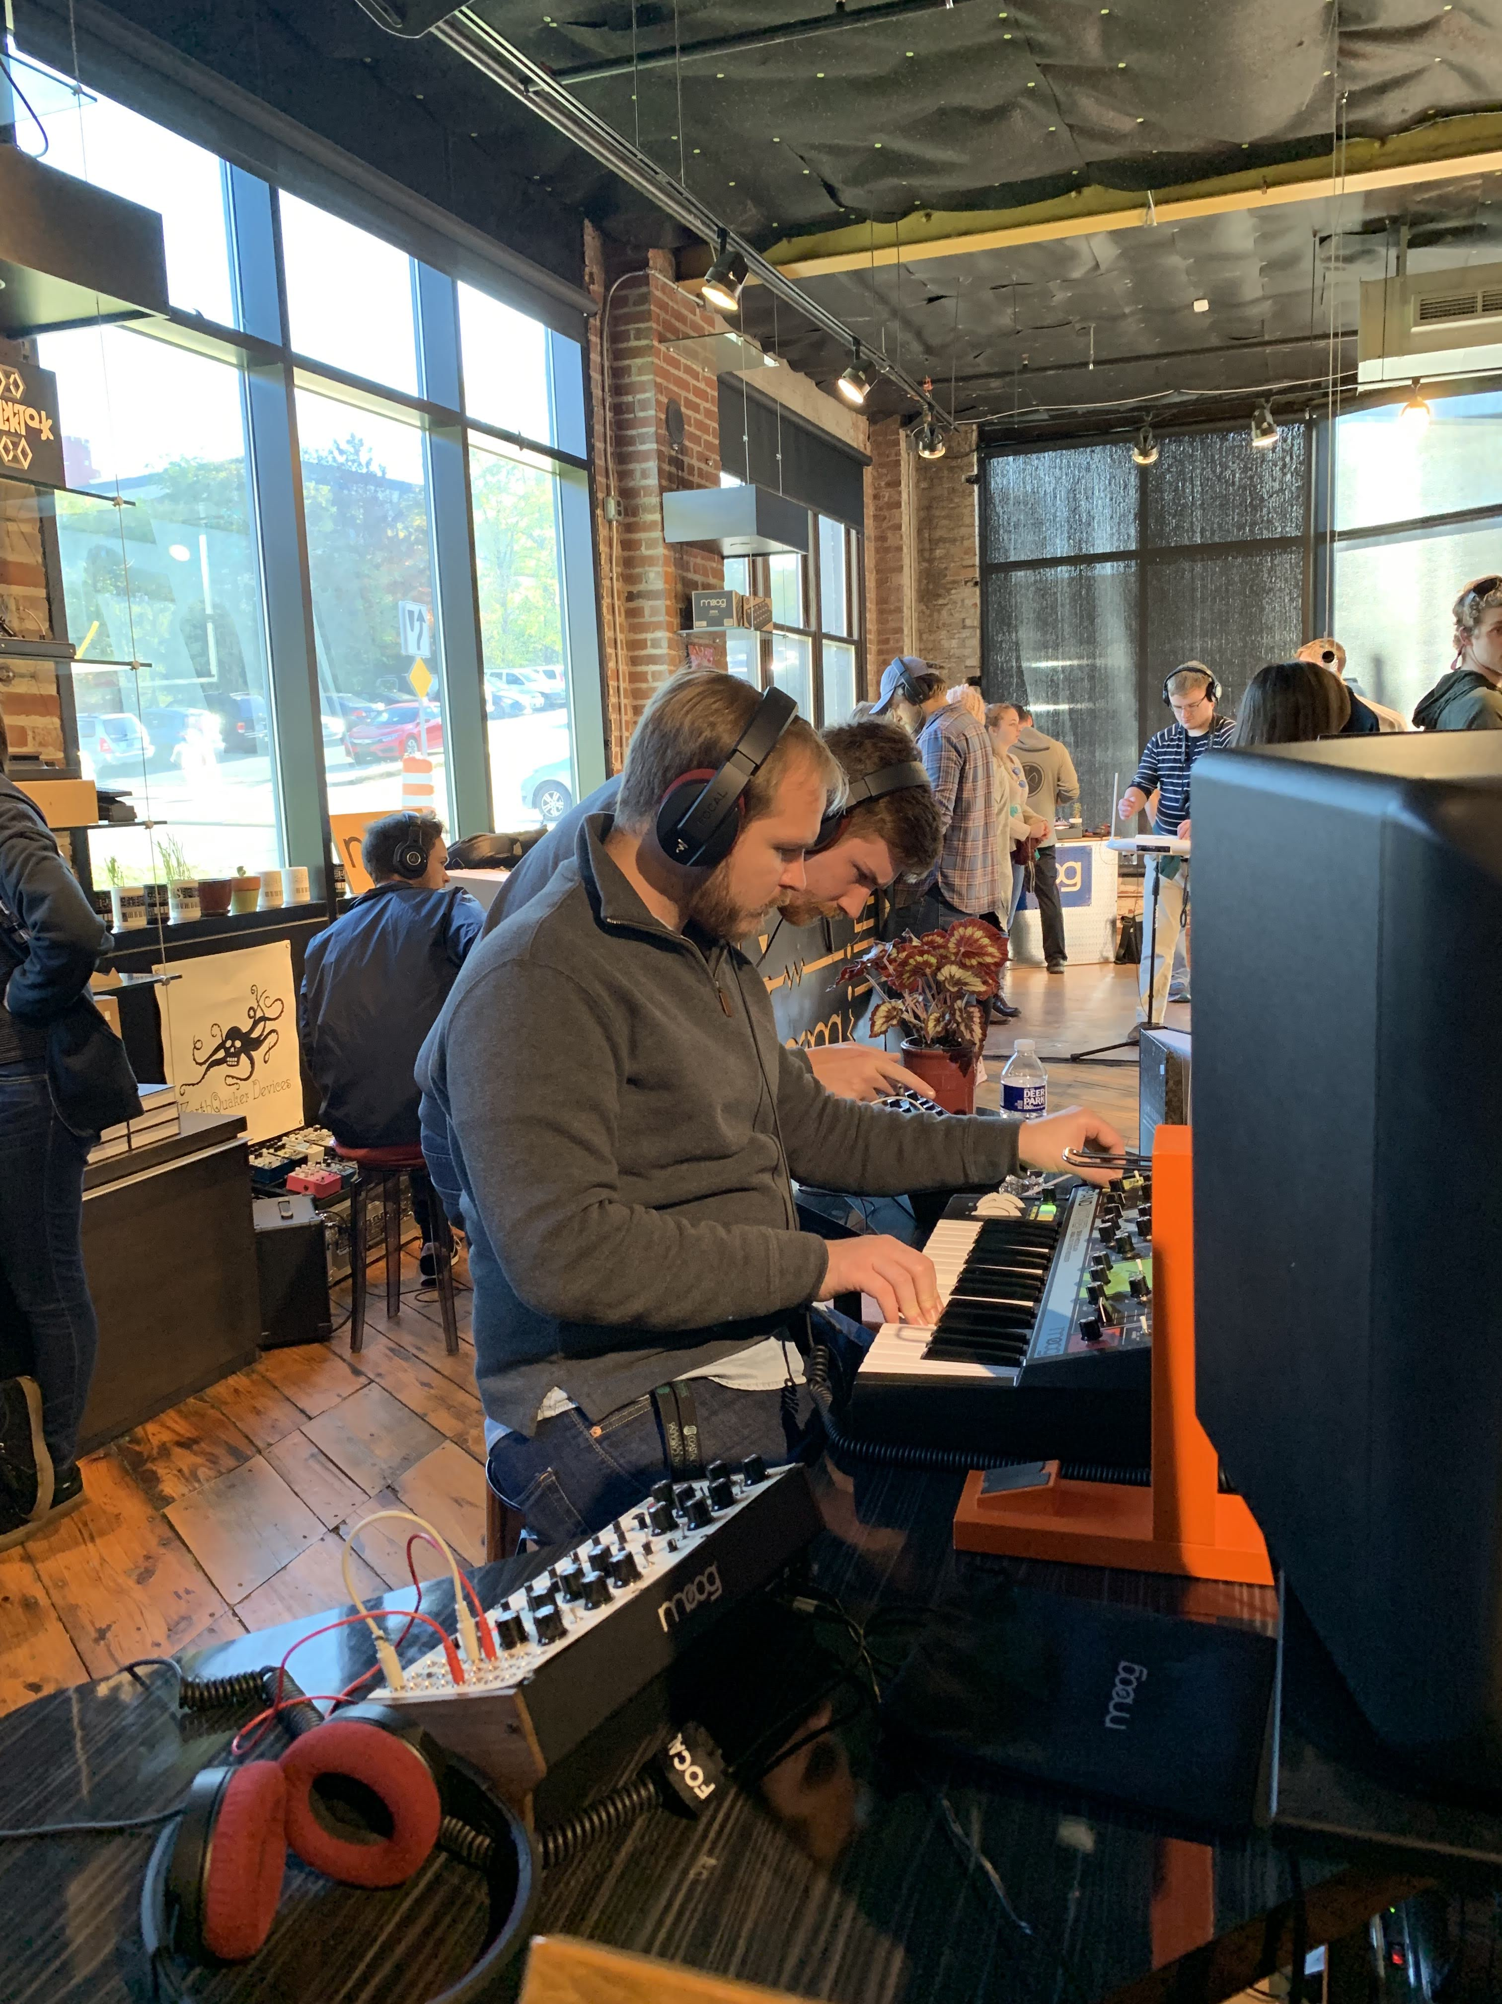
Master of Arts in Music Technology
Another newer program to Coastal’s graduate degrees, this exciting 30-credit-hour program focuses on technical and entrepreneurial skills required of a contemporary music technology professional.
Please open your chat to ask questions and visit https://www.coastal.edu/graduatestudies/ to request more information.

Slide 8
For More Information
Program Coordinator Professor Matthew White
mwhite@coastal.edu
843-349-4083
Please open your chat to ask questions and visit https://www.coastal.edu/graduatestudies/ to request more information.

Slide 9
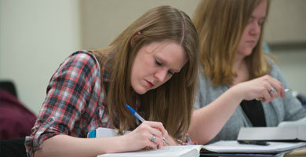
Master of Arts in Writing
The college’s first graduate program, this highly successful 33-credit-hour program in writing allows one to focus on professional writing, creative writing, and writing instruction.
Please open your chat to ask questions and visit https://www.coastal.edu/graduatestudies/ to request more information.

Slide 10
For More Information
Program Coordinator Dr. Christian Smith
csmith8@coastal.edu
843-349-6967
Please open your chat to ask questions and visit https://www.coastal.edu/graduatestudies/ to request more information.

Slide 11
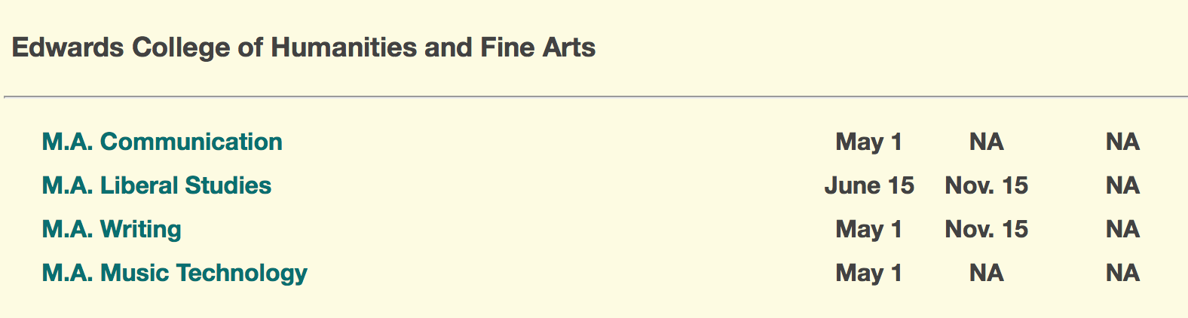
To Apply
www.coastal.edu/graduatestudies/applynow/
All standardized testing requirements for Fall applications have been waived due to the Covid-19-related closure of testing centers.
Submit Graduate Assistantship Application at the same time.
Due dates:
Please open your chat to ask questions and visit https://www.coastal.edu/graduatestudies/ to request more information.

